Slide 1
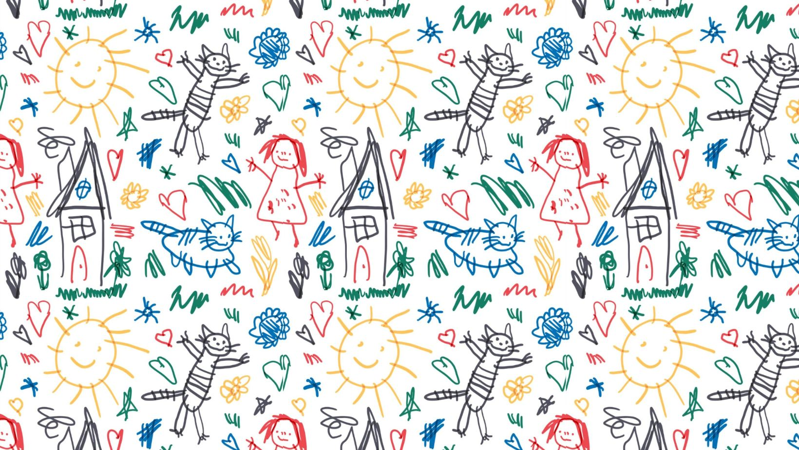
Marketing Report
February 4th, 2024 Charlie Roberson

Slide 2
Digital Marketing Reach—CBS 17

Slide 3
Digital Marketing Reach—CBS 17

Slide 4
Digital Marketing Reach—CBS 17

Slide 5
Digital Marketing Reach— FOX 8
Fox 8 and our web developer will be working together to implement UTM tags so that we can get a better handle on donations coming in from people who are coming from Fox 8. I will have more info on this by the next meeting. I will also be implementing UTM tags for all social media campaigns.

Slide 6
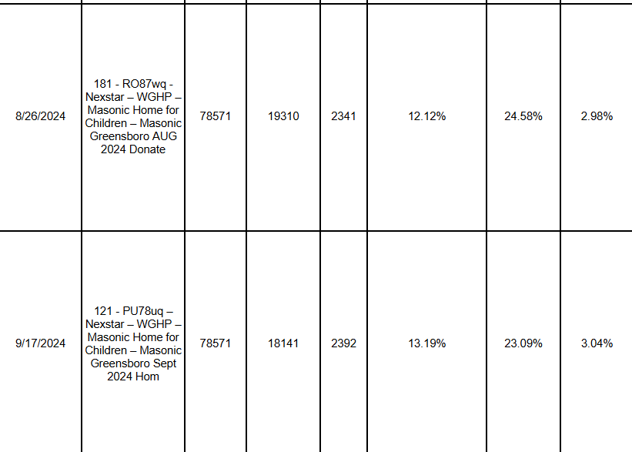
Digital Marketing Reach—FOX 8

Slide 7
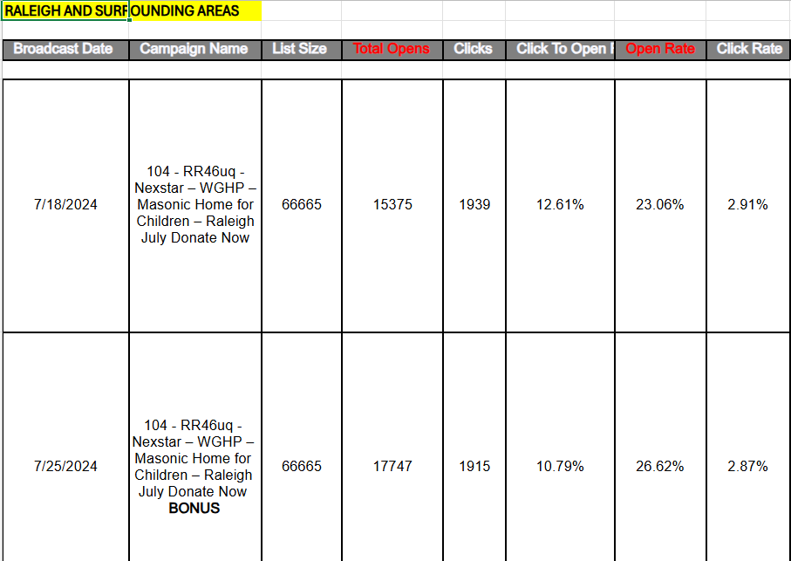
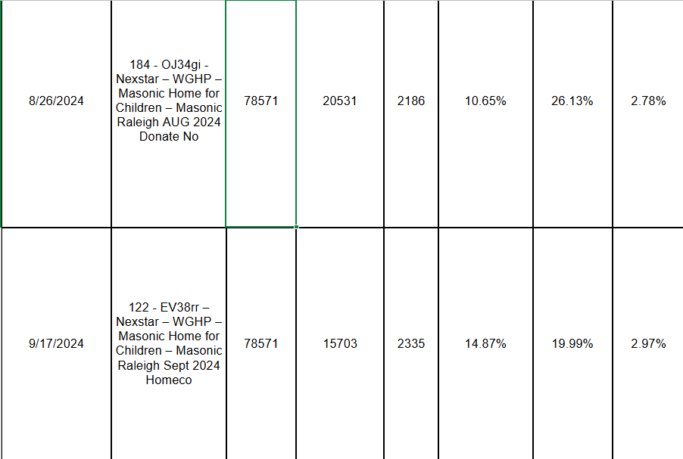
Digital Marketing Reach—FOX 8

Slide 8
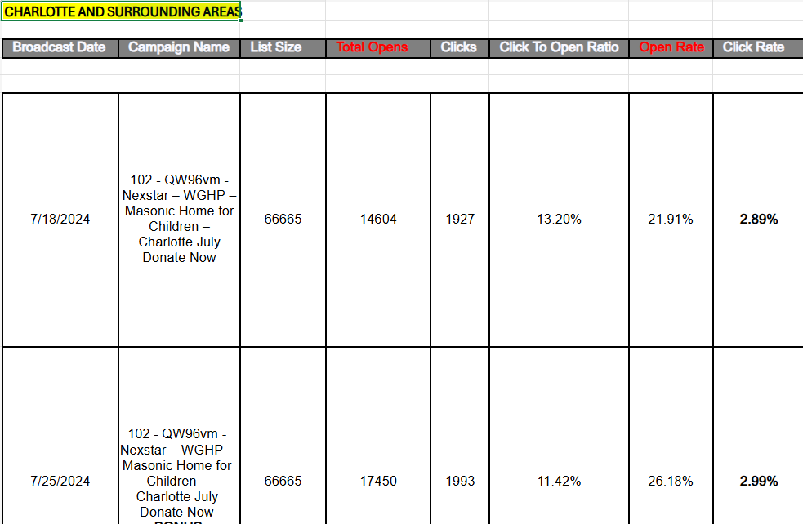
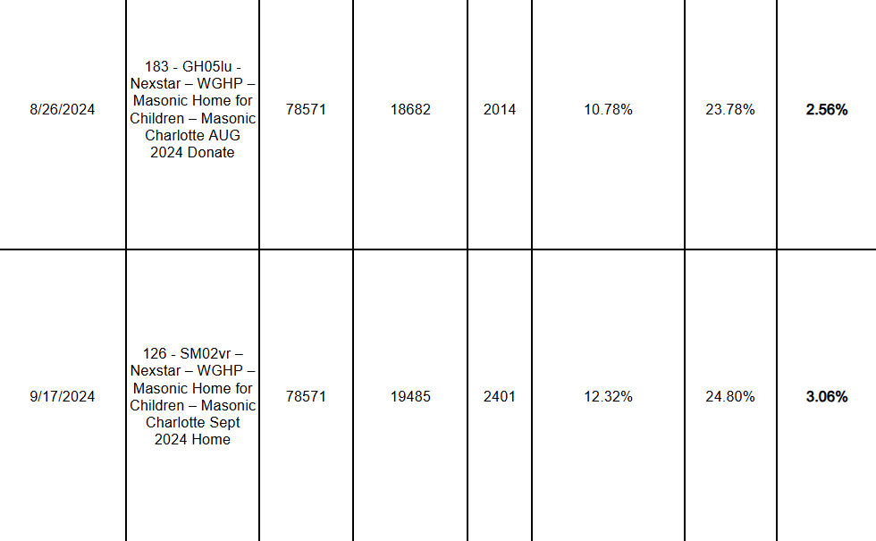
Digital Marketing Reach—FOX 8

Slide 9
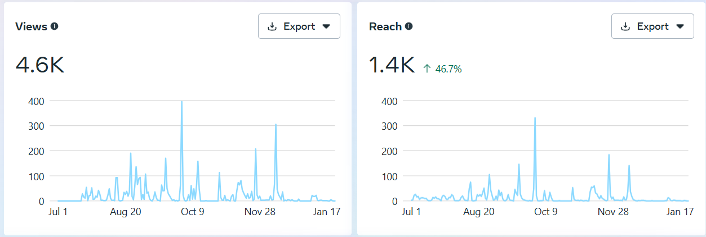
Instagram

Slide 10
Facebook

Slide 11
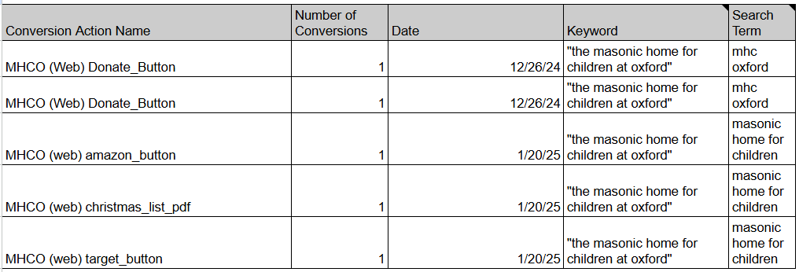
Google Grant
Performing much slower than anticipated, Kiersten, the GG manager, is looking into it with Google reps to see what adjustments can be made to increase visibility.

Slide 12
Website Analytic Report
Compiled since last meeting 10/30/24
Page views: 15,119 First time views: 8,224 Returning views: 1,170
For our Giving Tuesday/Dan Rice Challenge boosted posts we saw a 309% increase in views overall. We saw $1430 in Simple Give donations specifically for Giving Tuesday. There were other first time donations made on those days, but the donors did not notate what it was for, so I didn’t include them in my total. There could be more, but donors who send in checks typically do not list how they heard about us, or what caused them to donate—just how they want it to be used.

Slide 13
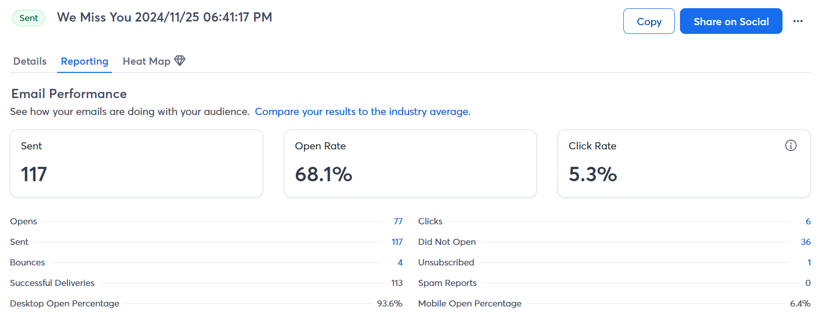
Emails
This email blast was sent to donors who have not contributed since 2022. As you can see, well above the industry average even with the 117 who didn’t open it. This is due to them not checking their email, it going to spam, undelivered, or they have passed away.

Slide 14
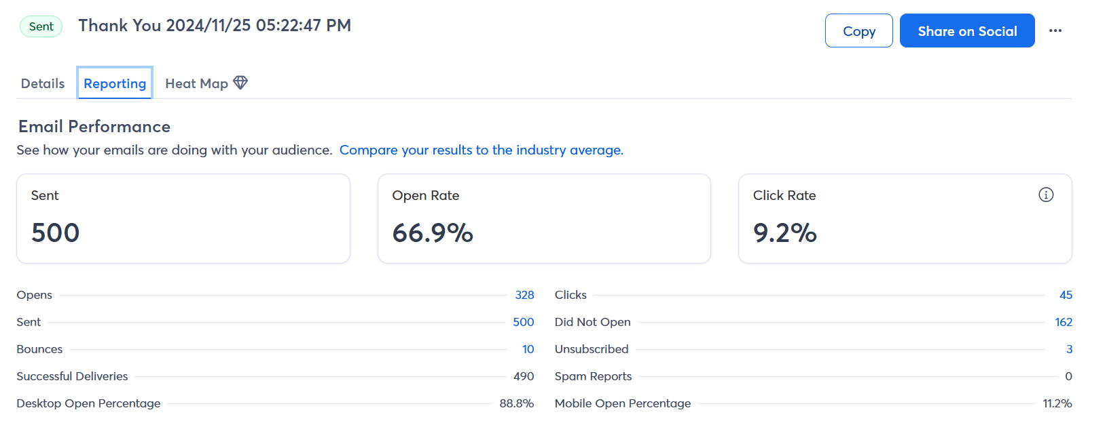
Emails
This email blast was sent to donors who contributed in 2024. Well above the industry average for open rate, click rate and bounce rate. Looking into why so many are unopened.

Slide 15
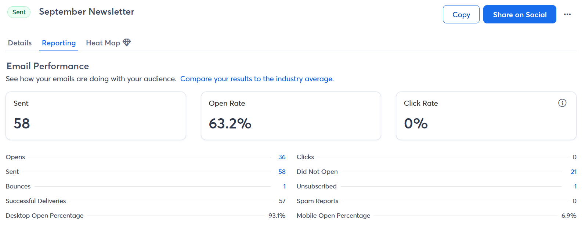
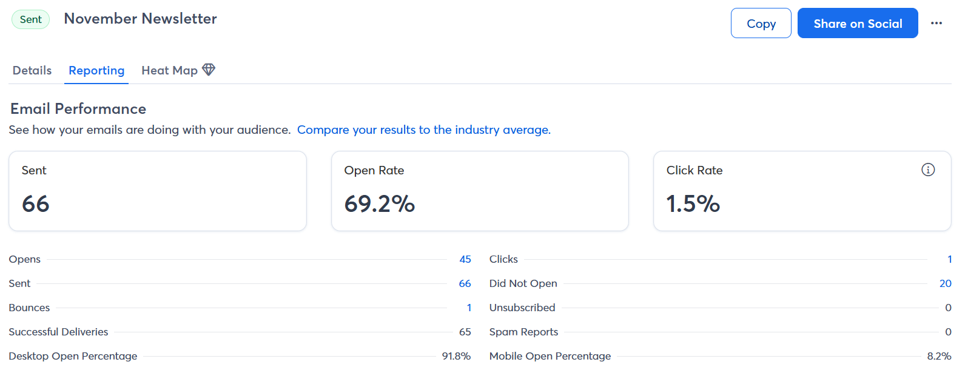
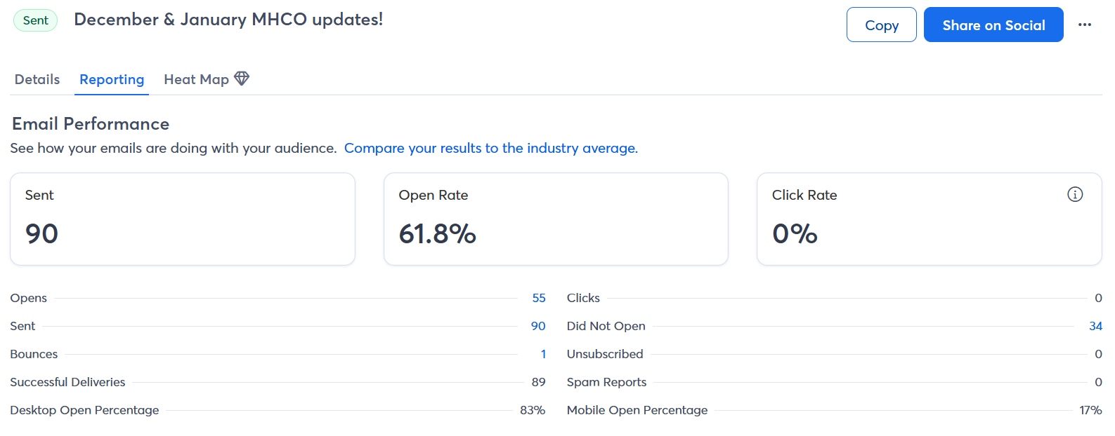
Newsletter—Red Devil Dispatch
Sept/Oct
2024
I only send this newsletter to people who have specifically signed up for it. It is meant for the general public (people who do not receive childrens chatter, as CC has information in it that the general public shouldn’t be privy to). A way to bridge the gap between us and the community.
November
2024
Dec/Jan
2024

Slide 16
Newsletter—cont.
Along with posting a sign up link on social media, I have implemented another entry field on the giving platform that allows donors to opt in for newletters and updates. This has been implemented since early January. This includes new donors/one time donors only. I plan on sending an email campaign to recurring donors that has a link to the newsletter sign up page if they are interested.

Slide 17
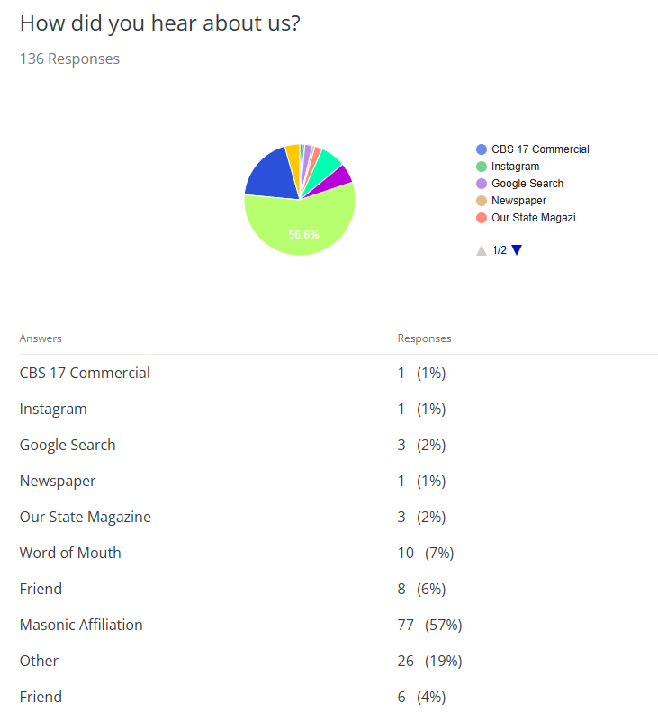
How we are getting our donations—
These analytics are pulled from our donation platform, Simple Give. I added a mandatory entry field that requires donors to tell us where they came from. Most are Masonic affiliated. This has only been implemented since early December, so I look forward to seeing how these insights progress over time. Options that are on the giving platform that have not been utilized by donors yet include: Fox8 commercial, radio, and Facebook. *Please note: this mandatory entry field was implemented after we boosted the Giving Tuesday posts. We have received donations from that campaign. (12/7)

